Slide 1


6999
Computing and Data Science​
6200
Computing and
Data Science (Delta+)
Bachelor of Engineering in Computer Science [BEng(CompSc)]
Bachelor of Engineering in Artificial Intelligence and Data Science [BEng(AI&DataSc)]

Slide 2

About School of Computing & Data Science (CDS)
Empowering Changemakers of the Future
  Newly established school at The University of Hong Kong
  Encompasses the Department of Computer Science and the Department of Statistics and Actuarial Science
  Aims to foster innovation, collaboration, and excellence in the vital fields of
- - - -
Computing Statistical Sciences Data Science Artificial Intelligence

Slide 3



International rankings
of HKU
#1
#11
in Asia (2026)
in the world (2027)
#18
Data Science and Artificial Intelligence (2026)
#6
#33
in Asia (2026)
in the world (2026)

Slide 4



6200 Computing and Data Science (Delta+) ​
6999 Computing and Data Science ​
BEng(CompSc) and BEng(AI&DataSc)
Computing and Data Science (programme codes: 6999 & 6200) offer the choices of two professional degree programmes, namely: (1) Bachelor of Engineering in Computer Science [BEng(CompSc)], and (2) Bachelor of Engineering in Artificial Intelligence and Data Science [BEng(AI&DataSc)]. Students admitted to 6999 & 6200 Computing and Data Science are free to choose (i.e., no quota limit applies) either of the aforesaid programmes.
Programme Selection
All students will be enrolled with BEng(CompSc) by default; and they can choose the final programme [BEng(CompSc)] or [BEng(AI&DataSc)] freely by the closer to the end of Semester 2 of AY2026-27 via online form.

Slide 5
6200 Computing and Data Science (Delta+) ​
6999 Computing and Data Science ​
Bachelor of Engineering in Computer Science [BEng(CompSc)]

Slide 6



6200 Computing and Data Science (Delta+) ​
6999 Computing and Data Science ​
Bachelor of Engineering in Computer Science [BEng(CompSc)]
Comprehensive Knowledge
Landscape
- -
Bachelor of Engineering in Computer Science has been accredited by
The Hong Kong Institution of Engineers
Strong foundation in computer science and its applications Covers a wide range of topics:
  Programming
  Algorithms
  Data structures
  Software engineering
  Computing infrastructures
  Artificial intelligence technologies

Slide 7
6200 Computing and Data Science (Delta+) ​
6999 Computing and Data Science ​
Bachelor of Engineering in Artificial Intelligence and Data Science [BEng(AI&DataSc)]

Slide 8

6200 Computing and Data Science (Delta+) ​
6999 Computing and Data Science ​
Bachelor of Engineering in Artificial Intelligence and Data Science [BEng(AI&DataSc)]
Comprehensive Knowledge Landscape
- -
Training students for careers in AI and data science Covers a wide range of topics:
  Programming
  Data modelling
  Big data systems
  Law and ethics in AI & DS
  AI technologies and applications

Slide 9
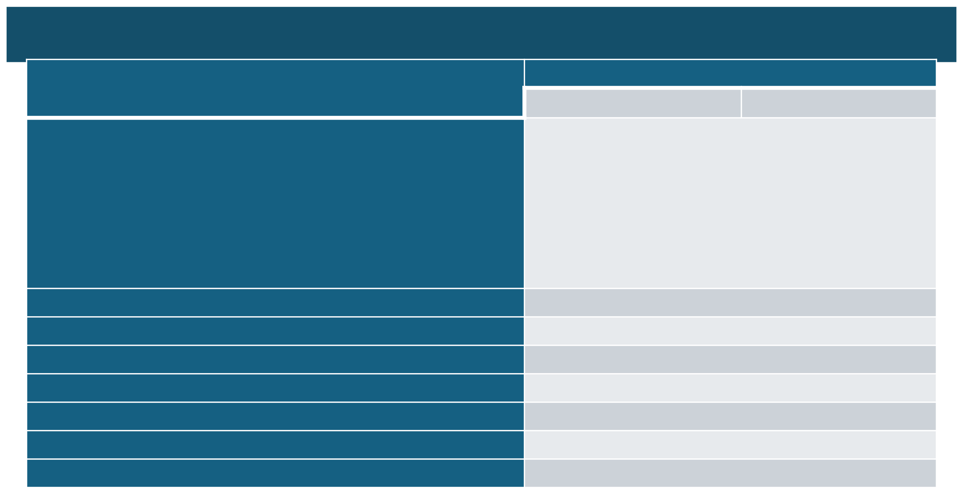
6200 Computing and Data Science (Delta+) ​
6999 Computing and Data Science ​
Curriculum Structure
No. of Credits
BEng(AI&DataSc)
BEng(CompSc)
UG5 University Requirements
- Language Enhancement Courses
- Common Core Courses
- AI Literacy Courses
- Non-credit bearing courses as required by the University
Foundation Courses
Disciplinary Core Courses (Introductory) Disciplinary Core Courses (Advanced) Capstone Experience and Internship Disciplinary Elective Courses
Elective Courses
54
36
24 30 18 36 42 240
Total:

Slide 10
6200 Computing and Data Science (Delta+) ​
6999 Computing and Data Science ​
Language Enhancement Courses – English Courses
CAES1001 Academic Communication in English
  Students who achieved Level 5 or above in English Language in HKDSE are exempted from taking this course
  For the list of equivalent qualifications, please refer to Division’s first year student handbook 2026-27
  For non-local students with qualifications not listed in the aforesaid equivalent qualification list, you can apply the exemption by taking Academic Speaking and Writing test conducted by CAES
CAES9542 Technical English for Computer Science
  1st Semester of Year 4, please refer to Division’s first year student handbook 2026-27

Slide 11
6200 Computing and Data Science (Delta+) ​
6999 Computing and Data Science ​
Language Enhancement Courses – Chinese Courses
Local Students: To be advised in Year 3
Putonghua-speaking Students:
CUND9001 / CUND9002 / CUND9003 / CUND9004
International Students:
“Chinese Language” CHIN9501 or CHIN9511 / “Chinese Culture” CHIN9521 or CHIN9522
Please refer to Division’s first year student handbook 2026-27

Slide 12
6200 Computing and Data Science (Delta+) ​
6999 Computing and Data Science ​
Common Core Courses
Unless otherwise prescribed in the curriculum regulations and syllabuses, students are required to successfully complete 36 credits in the Common Core Curriculum, comprising at least 6 credits and not more than 12 credits from each Area of Inquiry. Students are not allowed to take more than 24 credits of Common Core courses within an academic year, except for students who are required to make up for failed credits as well as those who take courses offered in the summer semester which are optional. In addition, Common Core courses cannot be taken as free electives.
The five Areas of Inquiry (AoIs) are:
  Scientific and Technological Literacy (course code: CCSTxxxx)
  Arts and Humanities (course code: CCHUxxxx)
  Global Issues (course code CCGLxxxx)
  China: Culture, State and Society (course code: CCCHxxxx)
  Artificial Intelligence (course code: CCAIxxxx)

Slide 13
6200 Computing and Data Science (Delta+) ​
6999 Computing and Data Science ​
UGRE1001 Introduction to the Constitution, the Basic Law and the National Security Law
  This is a non-credit bearing course which is required by the University under Regulation UG5(f) of the Regulations for First Degree Curricula as part of the graduation requirements for all current Full-time and Part-time Undergraduates. New students can start to take this course after September 1, 2025.
  This course aims to provide a basic introduction of the Constitution, the Basic Law and the National Security Law. You can access the link at CEDARS-General Education for the information on this course. Please click here to access the “UGRE1001 Student Guide” on instructions for access to the course. (Login to HKU Portal is required.)
  Please refer to the page here for any latest updates on this course.

Slide 14





6200 Computing and Data Science (Delta+) ​
6999 Computing and Data Science ​
6999 Computing and Data Science
Exciting Opportunities
Internships
Final year project
Student exchange
programme
Apply skills and knowledge in real-world settings and gain practical experience
Apply skills to a specific
Equip students knowledge, skills, and values needed to become influential citizens in today's globalised world
problem or project in the field of computer science, AI and data science

Slide 15























Past Internships

Slide 16
6200 Computing and Data Science (Delta+) ​
6999 Computing and Data Science ​
Academic Integrity
Plagiarism is a serious offence in the academic world. It constitutes academic theft – the offender has ‘stolen’ some intellectual property and presented it as his or her own. Plagiarism speaks to a person’s integrity and honesty, stifles creativity and originality, and defeats the fundamental purpose of education.
In this University, plagiarism is a disciplinary offence. Any student who commits the offence may face disciplinary action. It is the responsibility of all students at all levels to familiarize themselves with proper academic practice of writing, citation and referencing. For detailed information about plagiarism, please visit the website at https://tl.hku.hk/plagiarism/.

Slide 17
6200 Computing and Data Science (Delta+) ​
6999 Computing and Data Science ​
Progression and Discontinuation
Unless otherwise permitted by the Board of Studies, students will be recommended for discontinuation of their studies if:
  They fail to complete successfully 36 or more credits in two consecutive semesters (not including the summer semester), except where they are not required to take such a number of credits in the two given semesters; or
  They fail to achieve an average Semester GPA of 1.0 or higher for two consecutive semesters (not including the summer semester); or
  They have exceeded the maximum period of registration specified in the Regulations for the Degree of BEng(AI&DataSc)/BEng(CompSc).

Slide 18
6200 Computing and Data Science (Delta+) ​
6999 Computing and Data Science ​
Disciplinary Matters
  The University upholds the highest standards of academic integrity
  Apart from plagiarism, cheating or misconduct by the student will be considered by the Disciplinary Committee
  The Committee will decide the penalty on each case, ranging from reprimand, suspension of studies or even expulsion from the University depending on the seriousness of the offence

Slide 19
6200 Computing and Data Science (Delta+) ​
6999 Computing and Data Science ​
Regulation and Syllabus for 6999 programme
Please refer to the Regulation and Syllabuse posted on the Division website at https://www.csai.cds.hku.hk/

Slide 20
6200 Computing and Data Science (Delta+) ​
6999 Computing and Data Science ​
Other Useful Information
Academic Advising and Scholarships Office
https://aas.hku.hk/
Academic Support and Examinations Section, Registry
https://www.ase.hku.hk/
CEDARS
https://cedars.hku.hk
HKU Co-operative Education Programme (Co-oP@HKU)
https://co-op.hku.hk/
Examinations Office
https://www.exam.hku.hk/
Information Technology Services & Student Information System
https://www.its.hku.hk/
University Health Service (UHS)
https://www.uhs.hku.hk/
Equal Opportunity Unit
https://www.eounit.hku.hk/en
Future Readiness Online Courses
https://fri.hku.hk/online-modules/

Slide 21

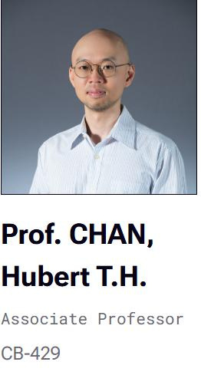
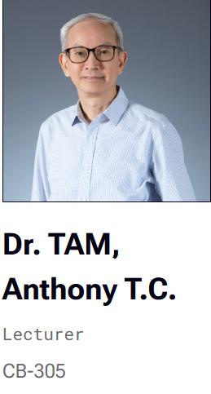
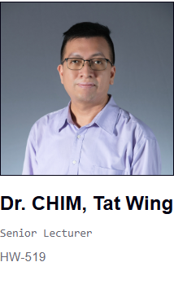
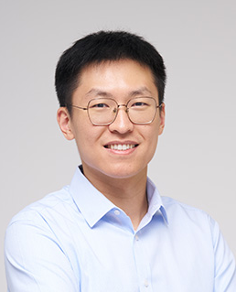
6200 Computing and Data Science (Delta+) ​
6999 Computing and Data Science ​
Further Enquires
Programme Director of
Programme Director of
School Academic Advisor
BEng(CompSc)
BEng(AI&DataSc)
Prof. WU,
Zhenqin

Slide 22
6200 Computing and Data Science (Delta+) ​
6999 Computing and Data Science ​
Thank you!
Contact us
Email: cs6999@hku.hk

